Slide 1
Database Management
Kelly Rossa Sungkono

Slide 2

Agenda
Review Last Exercise
Passive Database Active Database
View
Procedure
Function
Trigger
Class Exercise

Slide 3
Announcement
Next week (6th Meeting) : Quiz about Query with PostgreSQL (DDL, DML and Select)
10 Questions
Using PostgreSQL App (Open resource)
Time : 07.40 – 09.10 (90 minutes)
Cheating = 0

Slide 4
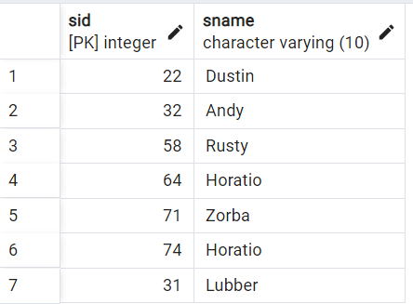
Class Assignment
Select the sid and name of sailor that has a rating greater than the rating average
SELECT sid, sname
FROM Sailors
WHERE rating >
(SELECT avg(rating)
FROM Sailors);

Slide 5
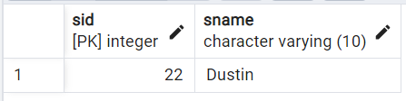
Class Assignment
2. Select the sid and name of sailor that has the most number of reservations
SELECT S.sid, S.sname
FROM Sailors S INNER JOIN Reserves R ON S.sid = R.sid
GROUP BY S.sid HAVING count(R.*) =
(
SELECT max(n.total)
FROM
(
SELECT S.sid, S.sname, count(R.*) as total
FROM Sailors S INNER JOIN Reserves R ON S.sid = R.sid
GROUP BY S.sid
) as n
);

Slide 6
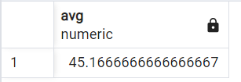
Class Assignment
3. Select the average age of sailors reserving ‘Interlake’ or ‘Marine’ boats
SELECT avg(age)
FROM Sailors s where s.sid in(
SELECT s1.sid from Sailors s1
INNER JOIN Reserves R ON s1.sid = R.sid
INNER JOIN Boats B ON R.bid = B.bid
WHERE B.bname = 'Interlake' OR B.bname = 'Marine');

Slide 7
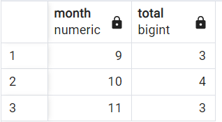
Class Assignment
4. Select the month and the number of reservations for each month
SELECT extract(month from day) as month, count(day) as total
FROM Reserves
GROUP BY extract(month from day);

Slide 8

Class Assignment
5. Select the percentage of red boat reservations of all reservations
SELECT 100*(SELECT count(*)
FROM Sailors S
INNER JOIN Reserves R ON S.sid = R.sid
INNER JOIN Boats B ON R.bid = B.bid
WHERE B.color = 'red')/(SELECT count(*) as total
FROM Sailors S
INNER JOIN Reserves R ON S.sid = R.sid
INNER JOIN Boats B ON R.bid = B.bid) as "percentage(%)";

Slide 9
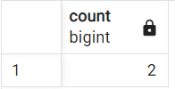
Assignment
Select a number of city of “Jawa Timur”
SELECT COUNT(*)
FROM PROVINSI P
NATURAL JOIN KOTA K
WHERE P.nama_provinsi = 'Jawa Timur';

Slide 10
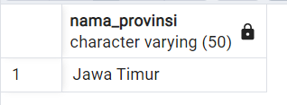
Assignment
2. Select the name of province that has maximum number of city
SELECT P.nama_provinsi
FROM PROVINSI P NATURAL JOIN KOTA K
GROUP BY P.id_provinsi HAVING count(K.*) =
(
SELECT max(n.total)
FROM
(
SELECT P.nama_provinsi, count(K.*) as total
FROM PROVINSI P NATURAL JOIN KOTA K
GROUP BY P.id_provinsi
) as n
);

Slide 11
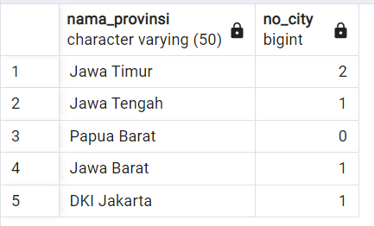
Assignment
3. Select all province’s name and the number of their cities
SELECT P.nama_provinsi, count(K.*) as no_city
FROM PROVINSI P
NATURAL LEFT JOIN KOTA K
GROUP BY P.id_provinsi;

Slide 12
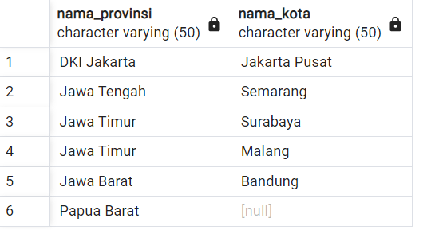
Assignment
4. Select name of provinces and name of cities of those provinces (if the province didn’t have city, the column ‘nama_kota’ will be null)
SELECT P.nama_provinsi, K.nama_kota
FROM PROVINSI P
NATURAL LEFT JOIN KOTA K;

Slide 13
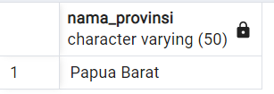
Assignment
5. Select name of provinces that don't have a city
SELECT P.nama_provinsi
FROM PROVINSI P
NATURAL LEFT JOIN KOTA K
WHERE K.id_kota is NULL;

Slide 14
Passive Database
Traditional Database Management System (DBMS) is passive = all command (query, update, delete) in database is running when requested by the user / application
However, some cases of database modeling cannot be effectively modeled by this pattern

Slide 15
Problem in Passive DB
Inventory control
Re-order items when the amount of stock in the warehouse is reduced to below the threshold.
Travel waiting list
Buy /sell stock when the price is above /below the threshold.
Stock market
Order tickets as soon as possible after the right one is available.

Slide 16
Active Database
Active database supports previous applications by moving reactive behavior from the application to DBMS
Active database can monitor and react to certain conditions that are relevant to the application
The active database system must support:
Knowledge model (example: description of mechanism), and
Execution Model (Example: Runtime Strategy) to support reactive behavior
Active rules: rules that are automatically triggered by events in the database

Slide 17
VIEW

Slide 18
View
View is a virtual table that contains result-set / query result.
A view containing rows and columns as in a structured table.
The columns in the view can come from one or more tables
View can be used as security
An information can be taken from a query view, not from the original table.

Slide 19
View Query
Create
CREATE VIEW view_name AS SELECT column_name(s) FROM table_name WHERE condition
Update
CREATE OR REPLACE VIEW view_name AS SELECT column_name(s) FROM table_name WHERE condition
Drop
DROP VIEW view_name
Display
SELECT * FROM view_name

Slide 20
View Query Example
Create
CREATE VIEW Products Above Average Price AS SELECT ProductName,UnitPrice FROM Products WHERE UnitPrice>(SELECT AVG(UnitPrice) FROM Products)
Update
CREATE OR REPLACE VIEW [Products Above Average Price] AS SELECT ProductID, ProductName,UnitPrice FROM Products WHERE UnitPrice>(SELECT AVG(UnitPrice) FROM Products)
Drop
DROP VIEW [Products Above Average Price]
Display
SELECT * FROM [Products Above Average Price]

Slide 21
Benefit using View
Can represent a subset of data in the DB thereby limiting the knowledge of outsiders of the DB
Can combine and simplify multiple complex tables
Hiding data complexity
Using a small space, instead of copying all the data represented

Slide 22
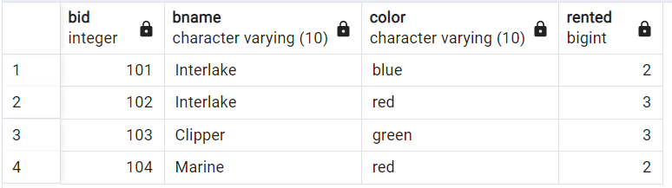
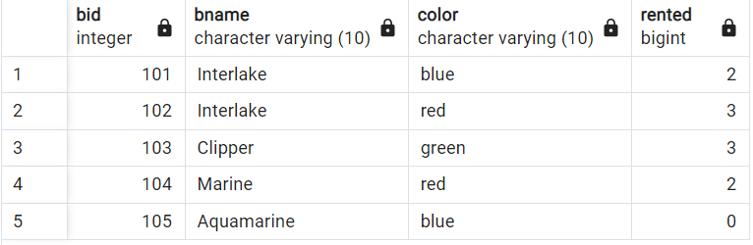
Example
CREATE OR REPLACE VIEW BoatRented_recap
AS
SELECT B.BID, B.BNAME, B.COLOR, COUNT(R.SID) AS RENTED
FROM BOATS B LEFT JOIN RESERVES R
ON B.BID = R.BID
GROUP BY B.BID,B.BNAME, B.COLOR
ORDER BY B.BID ASC;
SELECT * FROM BoatRented_recap;
INSERT INTO BOATS (BID, BNAME, COLOR)
VALUES (105, 'Aquamarine', 'blue');
SELECT * FROM BoatRented_recap;
the data on the view will increase and decrease according to the original table

Slide 23
PROCEDURE

Slide 24
Procedure
Procedure is a module that performs one or more actions.
A procedure can have zero to. many parameters.
Composed of two main parts:
Header: contains the procedure name and parameter list
Body: everything after the IS or AS keywords
REPLACE is optional
If REPLACE is not used, when you want to change the code in the procedure, the procedure must be dropped first and then re-created.

Slide 25
Syntax
CREATE OR REPLACE PROCEDURE name [(parameter[, parameter, ...])]
AS
[local declarations]
BEGIN
executable statements
[EXCEPTION
exception handlers]
END [name];
Syntax for execute procedure:
EXECUTE Procedure_name

Slide 26
Example (Procedure)
CREATE OR REPLACE PROCEDURE Discount
AS
CURSOR c_group_discount
IS
SELECT distinct s.course_no, c.description
FROM section s, enrollment e, course c
WHERE s.section_id = e.section_id AND c.course_no = s.course_no
GROUP BY s.course_no, c.description, e.section_id, s.section_id
HAVING COUNT(*) >=8;
BEGIN
FOR r_group_discount IN c_group_discount
LOOP
UPDATE course SET cost = cost * .95
WHERE course_no = r_group_discount.course_no;
DBMS_OUTPUT.PUT_LINE
('A 5% discount has been given to'||
r_group_discount.course_no||' '||
r_group_discount.description
);
END LOOP;
END;
Cursor digunakan dalam looping.
EXECUTE Discount

Slide 27
FUNCTION

Slide 28
Function
Function is a procedure that returns a value.
Functions can accept zero, one or more parameters but must have a return clause in the executable part of the function
The data type of the return value must be declared in the function header
Not stand-alone executable: must be used in a context,
The output of a function should be:
Put in a variable, or
Used in SELECT statements

Slide 29
Syntax
CREATE [OR REPLACE] FUNCTION function_name
(parameter list)
RETURNS datatype
IS
BEGIN
<body>
RETURN (return_value);
END;

Slide 30
Example (Function)
CREATE OR REPLACE FUNCTION show_description (i_course_no number)
RETURN varchar2
AS
v_description varchar2(50);
BEGIN
SELECT description INTO v_description FROM course
WHERE course_no = i_course_no;
RETURN v_description;
EXCEPTION
WHEN NO_DATA_FOUND
THEN
RETURN('The Course is not in the database');
WHEN OTHERS
THEN
RETURN('Error in running show_description');
END;

Slide 31
Example of Calling Function
SELECT course_no, show_description(course_no)
FROM course;

Slide 32
TRIGGER

Slide 33
Trigger
Triggers : a technique for specifying a particular type of active rules in a database.
A database that has a number of connected triggers is called an active database.
Triggers are like procedures that are automatically called by the DBMS in response to certain changes to the database.
Triggers monitor a database and are executed when the database undergoes changes that match event specifications.

Slide 34
Trigger Time Setting
Actions can be applied before or after the event trigger is executed.
BEFORE Trigger
Executes the action of the trigger before the trigger statement.
Eliminate unnecessary processes from trigger statements.
AFTER Trigger
This trigger is used if we want the trigger statement to be completed before executing the trigger action.

Slide 35
Trigger Syntax
CREATE OR REPLACE TRIGGER trigger_name
{BEFORE|AFTER} {event}
ON table_name
[FOR [EACH] ROW | STATEMENT]
EXECUTE PROCEDURE
trigger_function;
Unlike the other DBMS, PostgreSQL cannot create trigger without execute procedure

Slide 36
Row-Level Trigger vs Statement-Level Trigger
Row-Level :
Specified by FOR EACH ROW clause
fired for each row
Statement-Level:
Specified by FOR EACH STATEMENT clause
fired for each transaction

Slide 37
Trigger Example

Slide 38
Create Data Log for Auditing
create table Orders ( Order_no integer PRIMARY KEY, status varchar(10) );
insert into Orders (Order_no, status) values (1, 'process');
insert into Orders (Order_no, status) values (2, 'deliver’);
create table log ( ID_log integer GENERATED ALWAYS AS IDENTITY,
change_date date,
Order_num integer,
old_status varchar(10),
new_status varchar(10) );

Slide 39
Create Data Log for Auditing
CREATE OR REPLACE FUNCTION add_log()
RETURNS TRIGGER
LANGUAGE PLPGSQL
AS $$
BEGIN
INSERT INTO log (change_date, Order_num, old_status, new_status) values (now(), old.Order_no, old.status, new.status);
RETURN NEW;
END;
$$
CREATE OR REPLACE TRIGGER log_change
AFTER UPDATE ON Orders
FOR EACH ROW
EXECUTE PROCEDURE add_log();

Slide 40
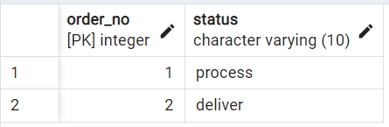
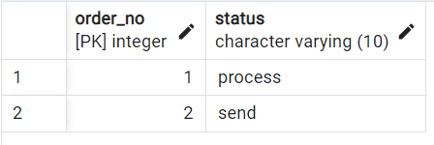
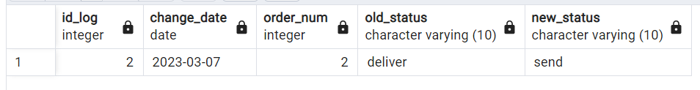
Create Data Log for Auditing
Orders Table before Update
Orders Table after Update on Order_No = 2
Add new row in Log Table after Update in Order Table

Slide 41
Automatically calculates column values
The Book table has 3 columns: columns id, price, and discount.
If the book price is more than 200, you will get a 20% discount.
When new book data is entered into Book, the discount column must be updated according to the price of the book.
How do you facilitate this process if there are additions and changes to records in the Book table?

Slide 42
Automatically calculates column values
CREATE OR REPLACE FUNCTION add_discount()
RETURNS TRIGGER
LANGUAGE PLPGSQL
AS $$
BEGIN
IF new.price > 200 then new.discount = 20/100*new.price;
ELSE new.discount = 0;
END IF;
RETURN NEW;
END;
$$
CREATE OR REPLACE TRIGGER add_discount
BEFORE INSERT OR UPDATE ON BOOK
FOR EACH ROW
EXECUTE PROCEDURE add_discount();

Slide 43
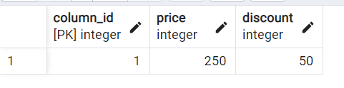
Automatically calculates column values
Book Table after Insert
INSERT INTO Book(Column_ID,Price) VALUES (1,250);

Slide 44
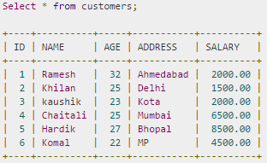
Class Exercise

Slide 45
Class Exercise
Create a view to displays name, salary and age of each customer who has salary more than 2000.00
Create a view to displays the name and percentage of each customer's salary to the total salary and is sorted from the largest percentage to the smallest percentage
Create a trigger to record a log that shows salary changes if there is a change in the salary (previous salary is different from the next salary). Columns in the log : IDLog, date, previous salary, next salary.
Create a trigger to ensure that the salary range entered in the customer table is 1500 - 8500 (if there is an insert / update salary > 8500, then salary = 8500 and if there is an insert / update salary < 1500 then salary = 1500)

